Slide 1
AI Fundamentals, MMAI 5000 S2 – Problem Solving Hemant Sangwan

Slide 2
Agenda
Problem and problem solving – in analytics and machine learning
Algorithm and problem solving
Flowcharts
Programming language and structure of a program
Environment types and problem solving strategies
Search algorithms

Slide 3
Problem solving, Algorithms, and Flow charts

Slide 4
Problem Solving
Problem: A set of barriers to achieve an objective
Purchasing an item online, calling your friends on WhatsApp
Fixing your python code for linear regression
Building an AI based customer service interface
Problem solving: A process to remove or overcome those barriers by performing a sequence of activities
It is possible the sequence being just ONE step in some scenarios
Not all problems can be solved – solutions do not exist; solutions exist but cannot be found
Lack of clarity on steps involved
Lack of clarity on inputs needed and end goal
Steps are known but cannot be executed
If you can solve a problem → the sequence of steps exist and executable → You can write an algorithm for it!

Slide 5
Algorithm
A sequence of activities to be processed for getting desired output from given inputs
Activities and their sequence must be clearly and unambiguously defined
Activities and their sequence must be completed in a finite time
The final goal is to reach to the desired outcomes
Before writing an algorithm → You need to identify inputs available to you and the desired outcome you want to achieve

Slide 6
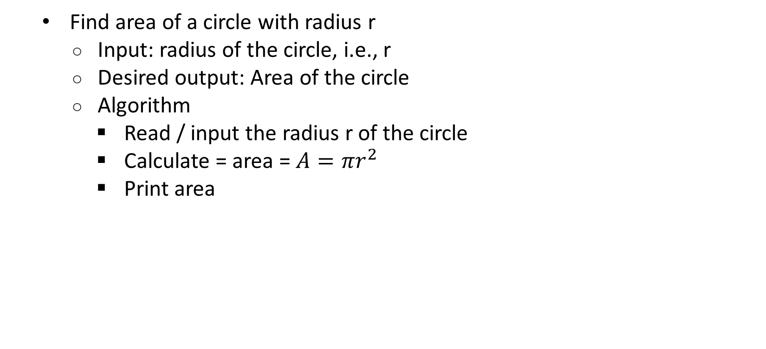
Algorithm – Area of a Circle
Find area of a circle with radius r
Input: radius of the circle, i.e., r
Desired output: Area of the circle
Algorithm
Read / input the radius r of the circle
Calculate = area = $A=πr^{2}$
Print area

Slide 7
Algorithm – Amount left after a grocery trip
On a grocery shopping trip, you have the budget of $100. You purchased the following items. Find the amount left with you at the end of this trip
Apple: 2 kg at a price $4/kg
Potatoes: 5 kg at a price $1/kg
Tomatoes: 1 kg at a price $3/kg
Cleaning supplies: $20
Canned food: $25
Before writing an algorithm for this, let’s first list inputs and desired output
Inputs: amount purchased of various items, price, total amount spent
Desired output: $100 - total amount spent

Slide 8
Algorithm – Steps
Step 1: total = 0, i=1 (i= item – apple, potatoes, cleaning supplies, etc.)
Step 2: read amount purchased and unit price for i
Step 3: total + 2 kg x $4 = $0 + $8 =$8 (initially total =$0 in step 1)
Step 4: i=i+1
Step 5: repeat step 2-4 for each item (potatoes, cleaning supplies, etc.)
Step 6: read total amount =$61, ($(8+5+3+20+25))
Step 7: amount left = $100-$61 = $39
Step 8: print amount left
Step 9: print “total items purchased”: i
–

Slide 9
Activity – Writing algorithms
Find factorial of N, where N is an integer
Find table of N, where N is positive and less than 10
Find perfect square in the range (1, 101). A perfect square is such that its square root is an integer
Calculate average age of a group of 10 Hollywood celebrities
Calculate monthly average of TSX index based on (Jan 2018-Dec 2020)
You do not have to write programs for the above problems, just algorithms with inputs, output clearly identified, and sequence of steps involved
–

Slide 10
Key characteristics of an algorithm
Finiteness: must terminate after N steps where N is finite. It also implies that after every step, the algorithm moves closer to solving the problem
Definiteness: each step in the algorithm must be clearly and unambiguously defined
Input: Any operation in the algorithm need beginning values. So initial values must be given even before an algorithm begins!
Output: The end results which have specified relations with inputs. If the results are from intermediate stage of the operation, then it is intermediate output
Effectiveness: The algorithm should be developed using “basic” operations (optional)
If a process does not meet ANY of the above 4 (+1 optional) properties →It is NOT an algorithm

Slide 11
Flowcharts – Visualizing algorithms
A visual representation of flow of data/information through processing system
A user can see operations performed and the sequence of those operations by looking at the flowchart
Start or end of the program
Input or output operation
Magnetic disk for secondary storage / backup
Decision making and branching operations
Writing steps of operations
Magnetic tape for secondary storage/ backup
Connector, joining two parts in FC

Slide 12
Importance of Flowcharts
Provide visual representations of an algorithm → easy to follow and understand
Structure and document complex problems
Serves as an important link between programming and business teams
Helps in planning a scenario analysis
Once a flowchart is complete → it is easy to write codes!
Anything else?

Slide 13
Activity – Drawing flowcharts
Find sum of the first 50 natural numbers (1+2+3…+50)
Find the largest number among (x,y,z), where (x,y,z) are integers
Your plan to purchase chocolate cookies on your next shopping trip
Your plan to invest 10% of your savings into stocks
You do not have to write programs for the above problems, just draw flowcharts using appropriate symbols and visuals
–

Slide 14
Activity – Algorithm
Read the following articles and share your experience in learning a new concept on the topic
Select a problem mentioned in one of the articles, and write an algorithm (not code) for the problem
Problem-Solving With Algorithms (Amy Pirzada, 2021). Retrieved from https://www.mycodingplace.com/post/problem-solving-with-algorithms
Algorithmic Thinking. Retrieved from https://teachinglondoncomputing.org/resources/developing-computational-thinking/algorithmic-thinking/

Slide 15
Need for Programming Languages

Slide 16
Why do we need Programming Language?
An algorithm or flowchart cannot run on a computer
You need to convert algorithm into a language that computer can understand
The language is called programming language (e.g., Python, R, C++, MATLAB, etc.)
Programming languages can be lower- or higher-level

Slide 17
A computer program
A sequence of instructions which dictates the flow of electronic signals within a computer system
The signals interact with computer memory, screen, keyboard to produce output which humans can use to perform tasks (e.g., adding two numbers), solve difficult problems, or play games. (lower-level programming)
At a higher level, the focus on more on completing a task or reaching an objective (e.g., playing games, writing a report, calculating profit, etc.) and not much about understanding lower-level activities (e.g., interaction of signals within computer)
The pattern of signals is represented by a sequence of 0s and 1s
100011001: yellow screen, 100011011: a pic of star on the display

Slide 18
Questions – Computer program
Can you produce a sequence of 0s and 1s which represents the program Adobe is using for converting Word documents to PDF? No
Do you know how many people, in the world, can produce such sequence?
Does the sequence differ between Windows vs Mac OS for the same program?

Slide 19
Lower- vs Higher-level programming language
Lower-level programming provides instructions which are technical in nature and at the most fundamental level of how computers work (e.g., converting one electronic signal to another type) to produce desired output
Higher-level programming languages like Python (or R, MATLAB, C++, etc.) have instructions written which are much closer to a natural language like English
In today’s time, programmers do not need to worry about the details of underlying hardware platform and its machine language. They can focus on higher level applications

Slide 20
Python is a Higher-level programming language
Higher-level programming languages like Python have instructions written which are much closer to a natural language like English
Easy syntax mimicking English and relatively easier to decipher codes
However, Python, like other languages, has strict syntax rules that must be followed to create well-formed programs
Example of a simple higher-level code (also called source code)
Income=100
Tax=34
NetIncome=Income - Tax
The code which computer can understand is called target code (or machine code)
A program or software (interpreter) converts source code into target code

Slide 21
Activity – Natural vs programming language
Can we write source code in natural language? Why or why not?
Agree or disagree – use concrete examples in your explanation
Natural languages, as they are used by most humans, are inherently ambiguous
It is not possible to write source codes in natural language as they are more difficult, and complex compared to computer programming languages
To understand just a small subset of a natural language, a human (or artificially intelligent computer system) requires background knowledge that is beyond the capabilities of today’s technological progress and software

Slide 22
Basic Structure of a Python Program

Slide 23
Structure of a program (or Python program)
Program header comments: The description used for clarification, e.g., # This is my first python program
Preprocessor directives: Special instructions for activities which need to be performed before the actual code compilation, e.g., importing library, e.g., import NumPy as np, import pandas as pd
Main (function): The point where program execution begins. It is the first function for the purpose of readability, e.g. filename = "C:/Users/Hemant.Sangwan/Data XYZ
Statements: These are main portion of the program and decides about the activities to be performed such as input operations, output operations, logical operations, etc. e.g., Y=x1+x2, or sales= price*quantity
Return: Statement which returns the value of the output, e.g., print (Y), print (sales)

Slide 24
Structure of a program (or Python program)
#Retail sales data #This is program header comments
import pandas as pd #This is preprocessor directive
from pandas import read_csv #This is preprocessor directive
filename = "C:/Users/Hemant.Sangwan/Downloads/OnlineRetail.csv" #This is main
sales = read_csv(filename, header=0, names=names, encoding = "ISO-8859-1") # This is a statement
sales['InvNo'] = sales['InvNo'].astype(int) #This is a statement
sales['CusID'] = sales['CusID'].astype(int) #This is a statement
prodsold= sales[['SKU','Descr','UnitP','Qty']] #This is a statement
prodsold= prodsold.assign(Rev = prodsold.UnitP*prodsold.Qty) #This is a statement
print(sales) #This is a return
print(prodsold) #This is a return

Slide 25
Problem solving Environment types and Search Algorithms

Slide 26
Environment types and Search Algorithms
Environment types
Problem solving strategies
Goal-based agents
Problem solving as search
Discrete optimization
Uninformed search
Breadth-first search (BFS)
Uniform-cost search
Informed search
Greedy search
Beam search
–

Slide 27
Environment characteristics and types
Observability (fully vs partially): How much of the environment’s state an agent’s sensors give it access to
Deterministic vs stochastic: Probability of transition between states. Deterministic if ptrans = 1, stochastic otherwise
Episodic vs sequential: Whether the choice of the action depends on past and/or future events (sequential), or just the current (episodic)
Single vs multi-agent: Whether single or more agents operate in the environment simultaneously
Discrete vs continuous: Are state transitions discrete (e.g., chess) or continuous (e.g., football)?
Static vs dynamic: Does the environment change without the agent taking an action?
Known vs unknown: Does the agent know the laws governing the environment?

Slide 28
Activity – Environment types
In which type of environment does a self-driving car operate?
Environment | Observable | Agents | Deterministic | Episodic | Static | Discrete
8-puzzle | Fully | Single | Deterministic | Episodic | Static | Discrete
Chess | Fully | Multi | Deterministic | Sequential | Semi | Discrete
Poker | Partially | Multi | Stochastic | Sequential | Semi | Discrete
Roomba | Partially | Single | Stochastic | Sequential | Dynamic | Continuous
Self-driving car | A | B | C | D | E | F

Slide 29
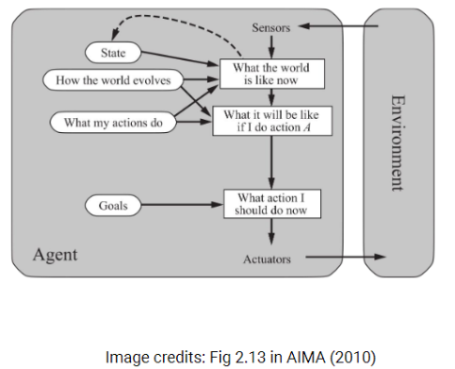
Problem solving strategies – Goal-based agents
Work towards a goal
Consider the impacts of actions on future states
Task: to find sequences of actions that lead to the goal
That is, search through possible solutions

Slide 30
Problem solving strategies – By search
Define the problem
Formulate a goal
Formulate a problem
Solve the problem
Explore possibilities by searching an internal model of the problem (“mental” or “offline”)
Execute found solution

Slide 31
Define the problem, i.e., problem formulation
Initial state: State in which the agent starts
States: All states that can be reached from the initial state, i.e., state space
Actions: The actions that the agent can take, i.e., action space
Transition model: What each action does (i.e., what is the result of taking an action in a state?)
Goal test: Determines if a given state is a goal state
Path cost: A function that assigns a cost to a path (sequence of actions) w.r.t. a performance measure

Slide 32
Problem solving strategies – Optimization
Types of optimization problems
Small (vs big)
Linear (vs non-linear)
Deterministic (vs non-deterministic)
Discrete (vs continuous)
Fully (vs partially observable)
Discrete optimization
State: x, state space: X, path cost: f(x)
Optimization max (f(x)) or min (f(x))
Examples of optimization problems
Find routes from York U to Finch station: Small, non-linear, discrete, deterministic, fully observable. Algorithms: classical search, e.g., UCS or BFS
Neural network optimization: Big, non-linear, continuous, deterministic, partially observable. Algorithms: Backpropagation and gradient descent

Slide 33
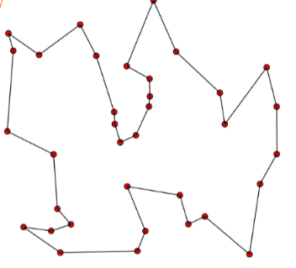
Examples of Discrete Optimization Traveling salesperson problem
Discrete optimization
State: x, state space: X, path cost: f(x)
Optimization max (f(x)) or min (f(x))
Traveling salesperson problem
“Given a list of cities and the distances between each pair of cities, what is the shortest possible route that visits each city and returns to the origin city?”
Size of state space ≤ n! (n is the number of nodes/vertices)
Path cost: total path length
Applications in planning, logistics, manufacture of microchips, etc.

Slide 34
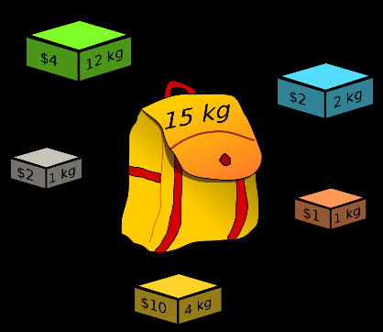
Examples of Discrete Optimization Knapsack problem
Knapsack problem
“Given a set of items, each with a weight and a value, select items so that the total weight is less than or equal to a given limit and the total value is as large as possible, i.e., keep the weight below a limit and the maximize value
Applications in selection of investments/portfolios, finding least wasteful ways to extract raw materials
Image source: Wikipedia

Slide 35
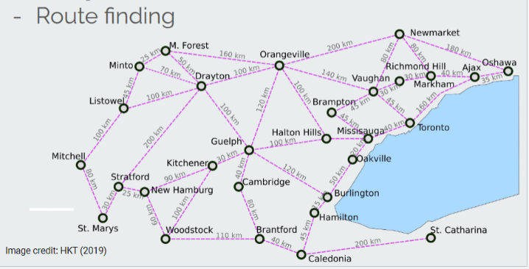
Examples of Discrete Optimization Route finding
States. In City/village where City ∈ {Guelph, Orangeville, Toronto, ...}
Initial state: In(St. Marys)
Actions. Go to a neighboring City. E.g. Go(Stratford)
Transition model. E.g. In(St. Marys), Go(Stratford) → In(Stratford)
What is the transition probability (ptrans)?
Goal test. In(Toronto)

Slide 36
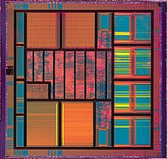
Real world examples of Optimization
Very Large-Scale Integration (VLSI) layout: Position millions of components and connections on a chip while minimizing area and shorten delays
Robot navigation: A special case of route finding where the robot navigates in 2D, or 3D space. State space and/or action space can be infinite. Although not necessarily discrete
Automatic assembly sequencing: Find an order in which to assemble parts of an object.
Protein design: Find an amino-acid sequence that will fold into a protein that will have some biological effect (e.g., cure a disease)
Image source: Wikipedia

Slide 37
Search algorithms

Slide 38
Structure – State space vs search space
State space: A physical configuration (in the “external world”)
Search space: An abstract configuration represented by a search tree or graph of possible solutions (in the “internal world”).
Search tree. A model of the sequences of actions
Root: initial state
Branches: actions
Nodes: results from actions. A node has parent, children, depth, path cost, and an associated state in state space
Expand: A function that given a node, creates all child nodes

Slide 39
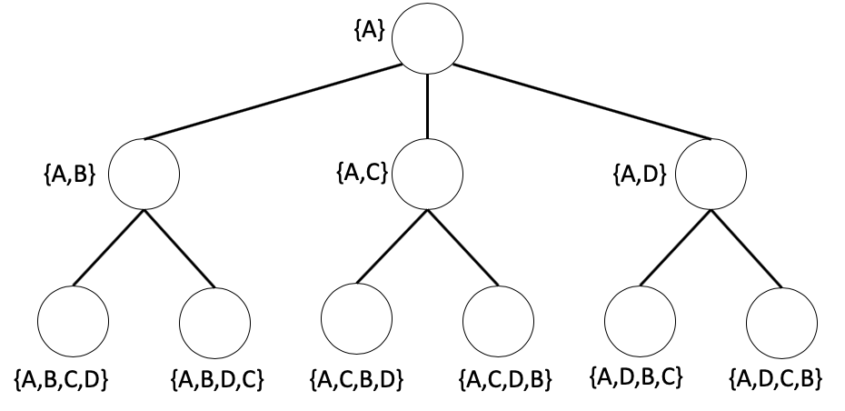
Structure – Search space regions
Explored – the nodes that have been visited
Frontier – the nodes currently in memory, i.e., the fringe
Unexplored – not visited and not in memory

Slide 40
Search strategies – types and evaluation
Strategy: a plan of actions under given scenario
A strategy is defined by the order of node expansion
Types of search strategies – informed and uninformed
Strategies are evaluated on the following four properties
Completeness: Does the strategy always find a solution if one exists?
Time complexity: Maximum number of nodes expanded
Number of steps an algorithm has to take to reach a solution
Space complexity: Maximum number of nodes in memory
Number of “memory units” an algorithm has to occupy to reach a solution
Optimality: Does the strategy always find the best solution?

Slide 41
Search strategies and complexity
Complexity, O, is a function of the input, n (worst or average case)
O(1) – constant
O(logn) – logarithmic
O(n) – linear
O(n^{c}) – polynomial
O(c^{n}) – exponential
O(n!) – factorial
Time and space complexity depends on
b: maximum branching factor (i.e., actions per state)
d: depth of the solution
m: maximum depth of the state space

Slide 42
Search strategies – uninformed and informed
Uninformed: no domain knowledge is used
Breadth-first search (BFS): expand shallowest node
Depth-first search (DFS): expand deepest node
Depth-limited search (DLS): DFS with depth limit
Iterative-deepening (IDS): DLS with increasing limit
Uniform-cost search (UCS): expand least cost node
Informed: domain knowledge is used. Use a heuristic that estimates how close a state is to the goal
Greedy search
Beam search

Slide 43
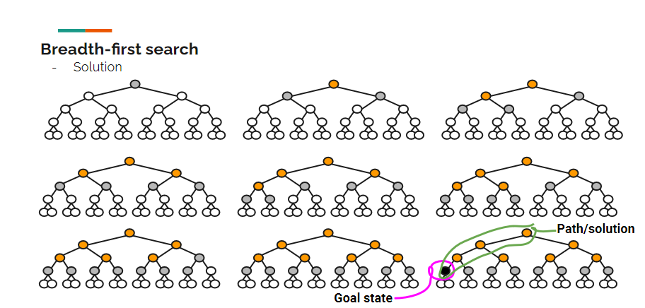
Uninformed search strategies – BFS
Breadth-First (BFS): Expand shallowest node first, i.e., node at the same level are reached first

Slide 44
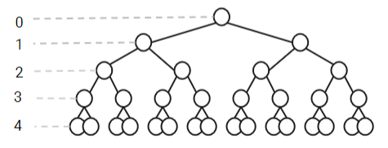
Breadth-First (BFS): Characteristics
Complete: Yes (if b is finite)
Time: 1 + b + b² + ... + b^{d} = O(b^{d})
Space: O(b^{d})
Optimal: Yes (if cost = 1 per step)
Exponential in space and time
b=2, d=4, b^{d} =16

Slide 45
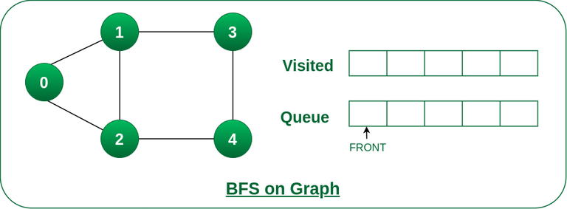
Breadth-First (BFS): Algorithm
Step 1: Consider the graph you want to navigate
Step 2: Select any vertex in your graph (say v1), from which you want to traverse the graph
Step 3: Utilize the following two data structures for traversing the graph
Visited array (size of the graph)
Queue data structure
Step 4: Add the starting vertex to the visited array, and afterward, you add v1’s adjacent vertices to the queue data structure
Step 5: Now using the FIFO concept, remove the first element from the queue, put it into the visited array, and then add the adjacent vertices of the removed element to the queue
Step 6: Repeat step 5 until the queue is not empty and no vertex is left to be visited.
Source: Breadth First Search or BFS for a Graph. Retrieved from https://www.geeksforgeeks.org/breadth-first-search-or-bfs-for-a-graph/

Slide 46
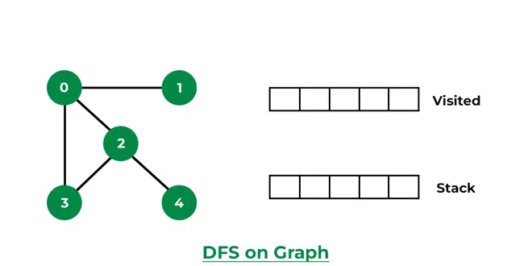
Depth-First (DFS): Algorithm
Step 1: Create a set or array to keep track of visited nodes
Step 2: Choose a starting node
Step 3: Create an empty stack and push the starting node onto the stack
Step 4: Mark the starting node as visited
Step 5: While the stack is not empty, do the following
Pop a node from the stack
Process or perform any necessary operations on the popped node
Get all the adjacent neighbors of the popped node
For each adjacent neighbor, if it has not been visited, do the following
Mark the neighbor as visited
Push the neighbor onto the stack
Step 6: Repeat step 5 until the stack is empty
Source: Depth First Search or DFS for a Graph. Retrieved from https://www.geeksforgeeks.org/depth-first-search-or-dfs-for-a-graph/

Slide 47
Activity – Applications of BFS, DFS, Uniform, and Greedy Searches

Slide 48
Recommended Readings
Problem-Solving With Algorithms (Amy Pirzada, 2021). Retrieved from https://www.mycodingplace.com/post/problem-solving-with-algorithmm
Algorithmic Thinking. Retrieved from https://teachinglondoncomputing.org/resources/developing-computational-thinking/algorithmic-thinking/
How to Develop Algorithmic Thinking in Data Structures and Algorithms? Retrieved from https://www.enjoyalgorithms.com/blog/how-to-develop-algorithmic-thinking-in-data-structure-and-algorithms

Slide 49
Appendix

Slide 50
A (simple) Search tree in Python
Function to create a node
Another function to add a child node
# Simple node
def get_node(name):
node = {}
node['name'] = name
node['children'] = []
return node
def add_child(node, name):
node['children'].append(get_node(name))

Slide 51
A (simple) Search tree in Python (cont’d)
# begin with the root node
tree = get_node('root')
print('Initialized the tree with root node', tree['name'])
# add a child node
add_child(tree, 'child1_d1') # child 1, depth 1
print('Added the child', 'child1_d1', 'to', tree['name'])
# and continue adding children to the tree
add_child(tree, 'child2_d1') # child 2, depth 1
print('Added the child', 'child2_d1', 'to', tree['name'])
add_child(tree['children'][0], 'child1_d2') # child 1, depth 2
print('Added the child', 'child1_d2', 'to',
tree['children'][0]['name'])
add_child(tree['children'][1], 'child2_d2') # child 2, depth 2
print('Added the child', 'child2_d2', 'to',
tree['children'][1]['name'])

Slide 52
A (simple) Search tree in Python (cont’d)
# print the tree
print('\t', tree['name'])
print(' \t/ \\')
print(' ', tree['children'][0]['name'], tree['children'][1]['name'])
print(' / \t\\')
print(tree['children'][0]['children'][0]['name'], '\t',
tree['children'][1]['children'][0]['name'])

Slide 53

Map as a search tree
tree = get_node('St. Marys')
add_child(tree, 'Stratford')
add_child(tree['children'][0], 'New Hamburg')
add_child(tree['children'][0], 'Drayton')
add_child(tree['children'][0], 'St. Marys')
add_child(tree, 'Mitchell')
add_child(tree['children'][1], 'Listowel')
add_child(tree['children'][1], 'St. Marys')

Slide 54
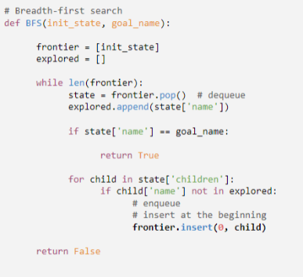
Uninformed search strategies – BFS (Python example)
The frontier is treated as a queue (FIFO, first in, first out), where nodes are enqueued from the front and dequeued from the end

